Slide 1


Six-Sigma Approach to Problem Solving Proposal Creation Cycle in GenTech
November 2023 | Team Seekers
Pragya Harshal Michelle Abhishek

Slide 2

Agenda
Define: Problem Definition
Measure: Process map & Baseline Metrics
Analyse: Exploratory Data Analysis
Improve: Recommendation
Control: Implementation Plan

Slide 3




Gen-tech Proposal Cycle | Problem Definition
Current State
Desired Future State
Gen-Tech is losing multiple bids to competitors, primarily due to its extended cycle time in the proposal creation process
~28% of the proposals from 2018 to 2020 took more than 35* days causing a potential loss of $2.5 B
The supply chain operations team wants to understand the existing bottlenecks and inefficiencies within the process leveraging the Six Sigma approach to streamline operations, reduce cycle time, and regain Gentech’s competitive edge
Successful implementation of a comprehensive framework to identify and address root causes of delays in the proposal creation process.
Approximately 20% reduction in the overall cycle time.
Streamlined the proposal creation cycle and regained the company’s competitive edge.
Potential generation of substantial revenue of $830 M/year through Six Sigma methodologies
Key Questions
Which specific steps or stages in the proposal creation process are taking the most time, and why?
Are there recurring issues or patterns in proposal delays that can be identified and addressed?
What data and metrics should be collected to assess and measure the performance and efficiency of the proposal creation process?
*Proposal creation cycle, longer than 35 days is considered as defect
Define

Slide 4
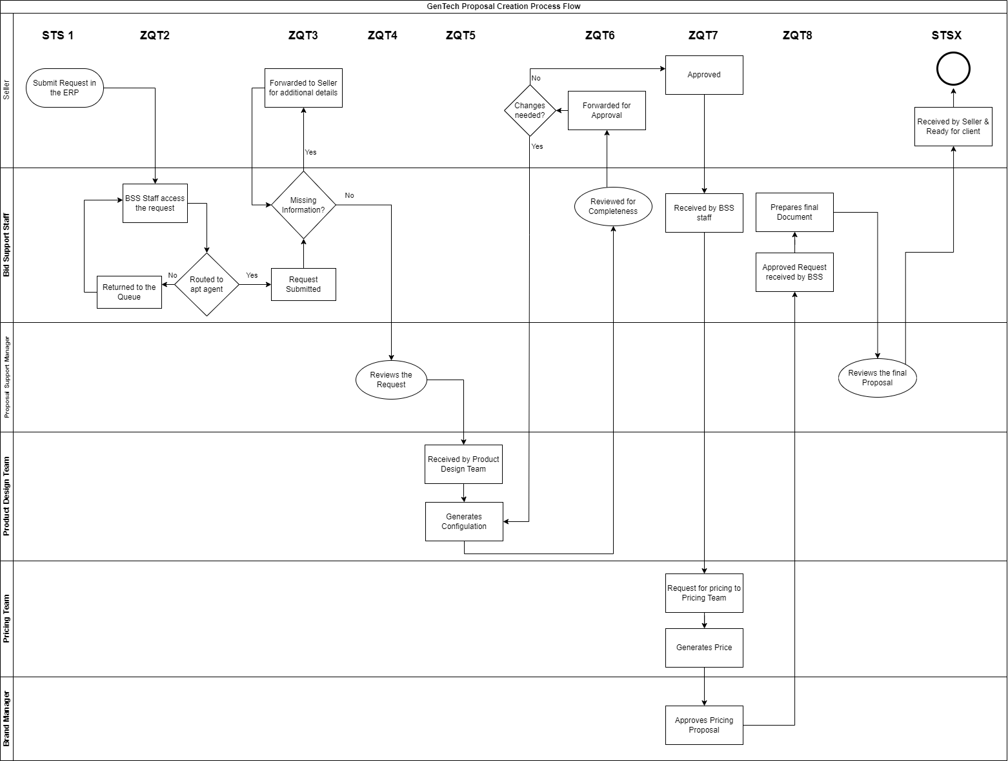

Gen-tech Proposal Cycle | Process Understanding
*2 2 3 4 2 7 3 7 2
Key Takeaways
The review and approval processes exhibit notable inefficiencies, in the 'ZQT6' and 'ZQT8' stages, where substantial time is consumed in iterative reviews and document preparation.
The proposal manager's review emerges within two of the top three most time-consuming stages.
Furthermore, with durations exceeding 35 days categorized as defects, Gentech's DPMO (Defects Per Million Opportunities) level is 281,049, resulting in a Sigma Level of 2.27.
*Average no. of days across each stage
Measure

Slide 5


Gen-tech Proposal Cycle | Duration Across Geography & Brands
Average Cycle Duration Across Geography (in days)
Average Cycle Duration Across Brands (in days)
* Average duration for proposal cycle is least in Japan
25%: <24days
50%: <27days
75%: <30 days
Eutope, MiddleEast, Asia
Cycle Point | Average Duration in Japan | Overall Average Duration | Japan Vs Overall Duration
STS1 | 2 | 2 | 1.0
ZQT2 | 2 | 2 | 1.0
ZQT3* | 2 | 3 | 0.6
ZQT4^ | 2 | 4 | 0.5
ZQT5 | 2 | 2 | 1.0
ZQT6 | 7 | 7 | 1.0
ZQT7” | 2 | 3 | 0.6
ZQT8 | 7 | 7 | 1.0
STSX | 2 | 2 | 1.0
Key Takeaways
Lesser iteration for seller inputs and quick review from proposal manager
All brands have similar process cycles, whereas, across geographies, Japan has the least cycle duration, consistently below the company benchmark of 35 days.
In Japan, 75% of proposals are processed within 30-days
The accuracy of inputs from sellers in Japan is a major contributing factor to its efficiency, with less than 50% of the time spent in stage ZQT3 compared to other locations.
Review and approval steps are also comparatively faster in Japan
Quick creation and approval of pricing proposal
Analyze

Slide 6
Gen-tech Proposal Cycle | Seller Analysis
Proposal Cycle of Sellers involved in longer Bid Process (>35days)
Distribution of BSS Feedback on the processes involving 5 underperforming Sellers
Out of 25 sellers, 5 sellers had an average proposal creation cycle of greater than 35 days.
Comparing their average duration (in days) across stages with the overall baseline values below:
BSS Feedback | % Of Total | Seller Vs Overall
Incomplete information | 10% | 1.02
Missing configuration details | 10% | 0.97
Error in address provided | 10% | 1.08
Missing seller information | 10% | 1.10
Documentation provided late | 10% | 1.00
Missing Customer address | 10% | 1.11
Brand approval takes too long | 7% | 1.06
Bid manager on vacation | 6% | 1.00
Pricing approval takes too long | 6% | 0.94
Multiple quote submissions | 5% | 0.94
Multiple submissions | 5% | 0.91
Configuration changed | 5% | 0.89
customer not in database | 3% | 0.91
System outage | 2% | 0.66
Key Takeaways
Lower-performing sellers cause an increment of over 2 times the duration of regular proposals in the request phase. The increased duration is mostly due to incomplete/ incorrect requests.
More than 50% of their proposals are flagged by BSS as incomplete or missing information
Apart from sellers' input, the review duration with the proposal support manager and pricing proposal cycle are also contributing to the delay in these processes
% Total= Distribution of each BSS feedback in processes involving low-performing BSS
BSS Vs Overall: %Total/ % distribution in all proposals
Analyze

Slide 7
Gen-tech Proposal Cycle | BSS Agent Analysis
Proposal Cycle of BSS involved in longer Bid Process (>30days)
Distribution of Seller Feedback on the processes with low-performing BSS (35+ days)
Duration | BSS Count
<35 days | 82
30-35 days | 36
35+ days | 18
Seller Feedback | *% Total | BSS Vs Overall
Difficult to identify BSS agent | 15% | 1.01
BSS inexperienced | 10% | 1.01
BSS lacks domain knowledge | 10% | 0.99
Incorrect configuration | 10% | 0.98
Proposal takes too long | 10% | 0.97
Submission process is tedious | 5% | 1.05
Responses rate is too slow | 5% | 1.05
too much churn | 5% | 1.05
Too many errors by BSS | 5% | 1.03
pricing is not competitive | 5% | 1.01
Errors in configuration | 5% | 1.00
Terms and conditions had errors | 5% | 1.00
Incomplete requirements | 5% | 0.98
ERP system doesn't work well | 4% | 0.89
Key Findings
18 of the 100 BSS agents are involved in the proposal cycle with an average duration of more than 35 days
These segments tend to be spending more time than the average across almost all the stages
More than 50% of their proposal errors are flagged as issues from the BSS agent end by sellers (such as inexperience, lacks domain knowledge, lower response, etc)
% Total= Distribution of each seller feedback in processes involving low-performing BSS
BSS Vs Overall: %Total/ % distribution in all proposals
Analyze

Slide 8
Gen-tech Proposal Cycle | BSS & Seller feedback Analysis
https://public.tableau.com/app/profile/harshal.gajera/viz/SellerReviewVsBidSize/Dashboard1?publish=yes
Analyze

Slide 9
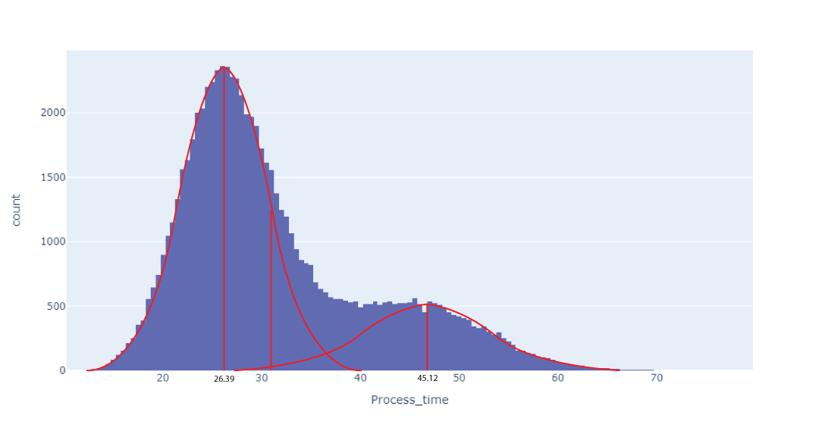
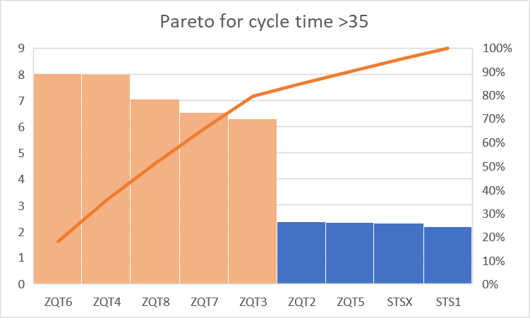
Gen-tech Proposal Cycle | Statistical Assessment
Histogram of Total Process Time
Pareto Chart for Cycle time >35
Key Findings
Analysis of our process has revealed two distinct normal distributions:
Cycles under 35 days and cycles exceeding 35 days.
Our improvement strategy involves the application of Lean Six Sigma principles to enhance efficiency (Lean) and effectiveness (Six Sigma).
This dual approach aims to shift the distribution to the left, reducing cycle times, and narrow it for consistent quality.
A Pareto analysis has identified ZQT6 and ZQT4 as the primary sources of prolonged cycle times.
Utilizing the 80/20 rule, we recognize ZQT6 and ZQT4 as critical bottlenecks requiring focused attention to improve cycle time efficiency.
Prioritizing these areas will contribute significantly to our goal of process improvement and operational excellence.
Analyze

Slide 10
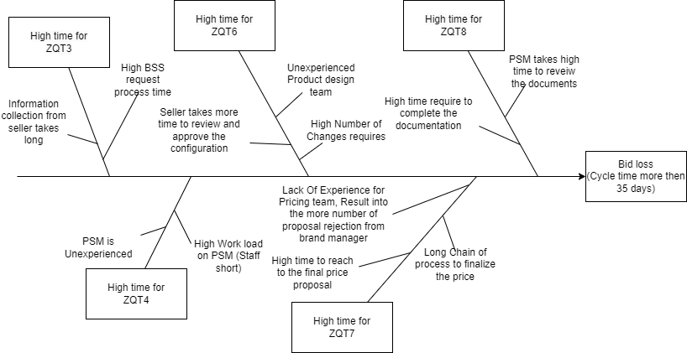
Gen-tech Proposal Cycle | Fishbone Diagram of cause and effect
Analyze

Slide 11
Gen-tech Proposal Cycle | Recommendation & Control
Phase 1 : Improving Efficiency
Improved UI portal with mandatory Inputs
Training Workshop for Sellers
Preset review guidelines
Delegate review authority to an alternate hierarchical role, such as a team lead, in the absence of the manager
Increase efficiency of the pricing team using Automation/ML approach to streamline the process
Upskilling BSS agents
Training Workshops
Hiring experienced resource
Upskill resources in Product design team to ensure less error
Final Design to pass through QC checklist
Recommendation
ZQT3
ZQT4
ZQT6
ZQT7
ZQT8
Conduct periodic usability testing to ensure user-friendliness and efficiency
Maintain records of seller attendance at training sessions
Foster collaboration between your pricing team and data scientists or ML experts to align pricing strategies with business objectives
Compliance assessment with the guidelines, and track any deviations or issues
Assess the progress of team members through skill evaluations and performance reviews
Having clear guidelines and workflows ensures consistency and efficiency
Control
Define and track KPIs related each stage for holistic evaluation on efficiency
Phase 2 : Improving Effectiveness
Shifting Focus from quantity to improving the quality of the proposal, thus ensuring more conversions/wins
Improve & Control

Slide 12
Thank You!

Slide 13
Appendix

Slide 14
Title of Project
Business Problem: |  | Executive Sponsor: Elliot Smith Black Belt Champion: Jeff Hugh
Objective and Scope Objective: Need to understand the existing bottlenecks and inefficiencies within the process Reduction of approximately 20% in the overall cycle time. Scope: Optimize the proposal creation process for efficiency, with a lesser balance on proposal quantity and quality. |  | Steering Committee: Elliot Smith (CEO, Gentech) Grace Monroe (VP of Supply Chain Operations) Jeff Hugh (Lean Six Sigma Black Belt) Sales Team Representatives
Process Owner: Grace Monroe, VP of Supply Chain Operations Black Belt: Jeff Hugh | Investment Internal Budget & Funds RISKS: Scope Creep Vendor Risks | Team Members Bid Support Team Pricing Team Product Design Team
Gen-Tech is losing multiple bids to competitors, primarily due to its extended cycle time in the proposal creation process. ~28% of the proposals took more than the upper limit of 35 days causing a potential loss of $2.5 B from 2018 to 2020
DMAIC | Start / End | Operational Metric | Baseline | Target
Define | Week 1 |  | 32 days | Reducing Average proposal time to <25 days
Measure | Week 2
Analyze | Week 3 to Week 8 | Expected Benefits |  | Projected Savings
Improve | Week 9 – Week 12 | Realized substantial revenue of $830 M/year through Six Sigma methodologies. Aiming for a targeted reduction of approximately 15% in the overall cycle time. Enhanced efficiency and competitiveness within Gen-Tech's supply chain operations. |  | $ 830M/year
Control | Week 10– Week 12
Average Duration/Bid
Defect: Proposal with total Duration >35 days

